Slide 1
Ping Pong -
Micro:Bit Tutorial
Ola, Maruan & Ivy

Slide 2
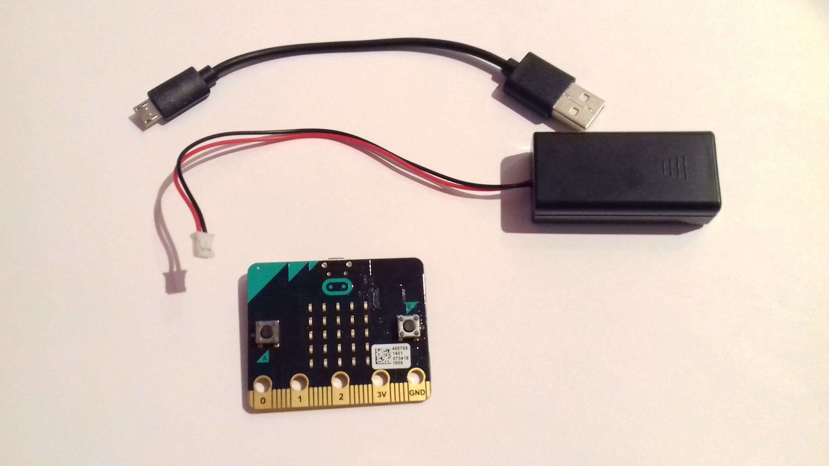
Equipment - Hardware
Micro:Bit Power Board x1
USB Cable x1
Battery x 1 (optional)

Slide 3
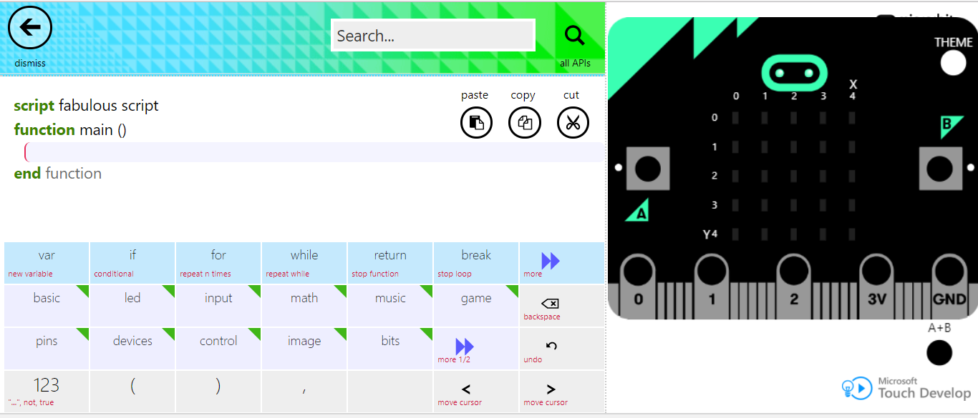
Creating The Script
Go to: https://www.microbit.co.uk/app/#edit:fb1a65ea-3141-44d6-6824-605a1740f752:xtlIVRuMnu46U4bA
Use the buttons to create your script

Slide 4
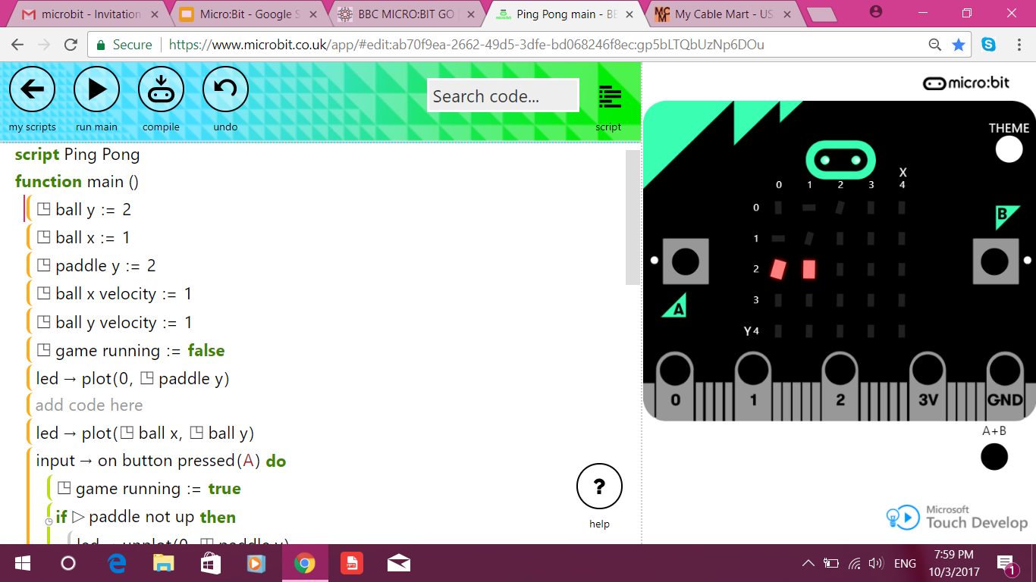
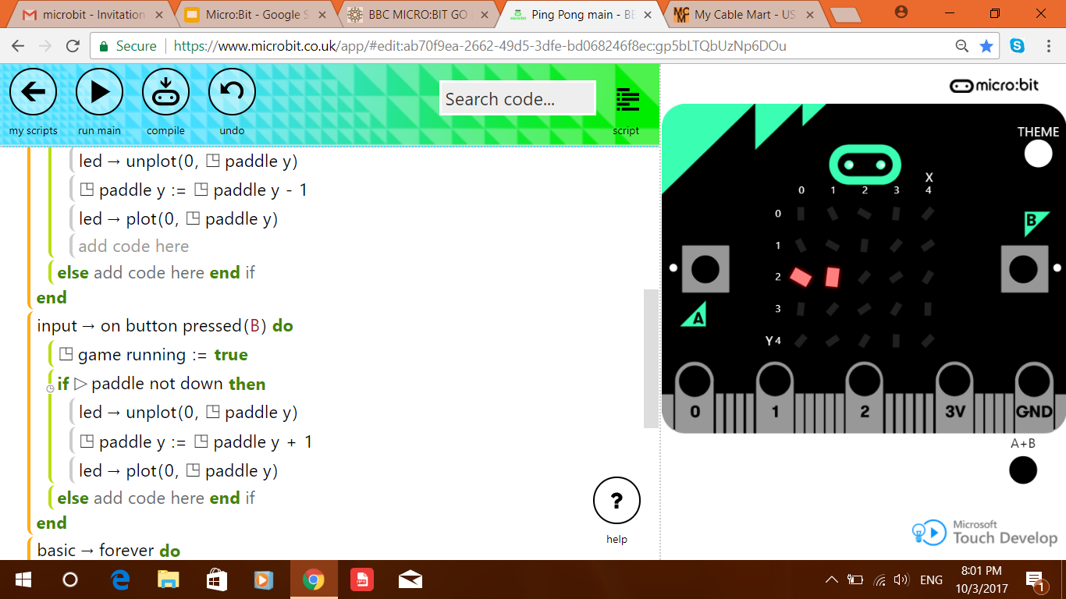

Function 1

Slide 5
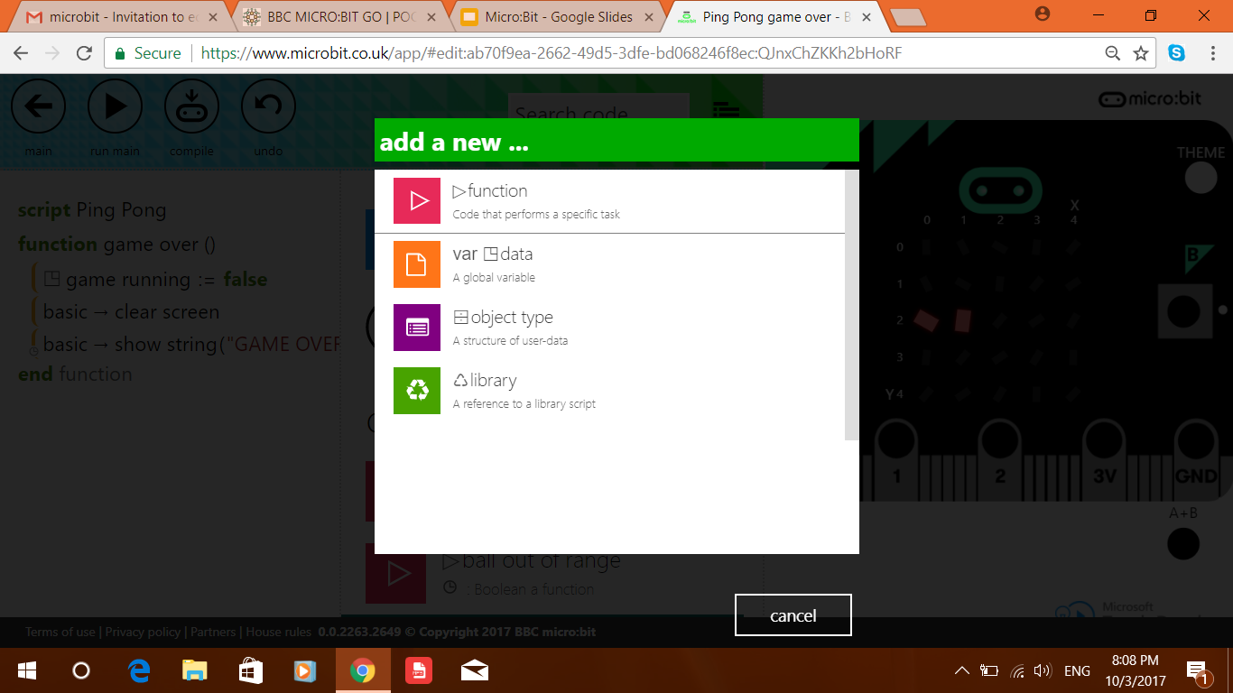
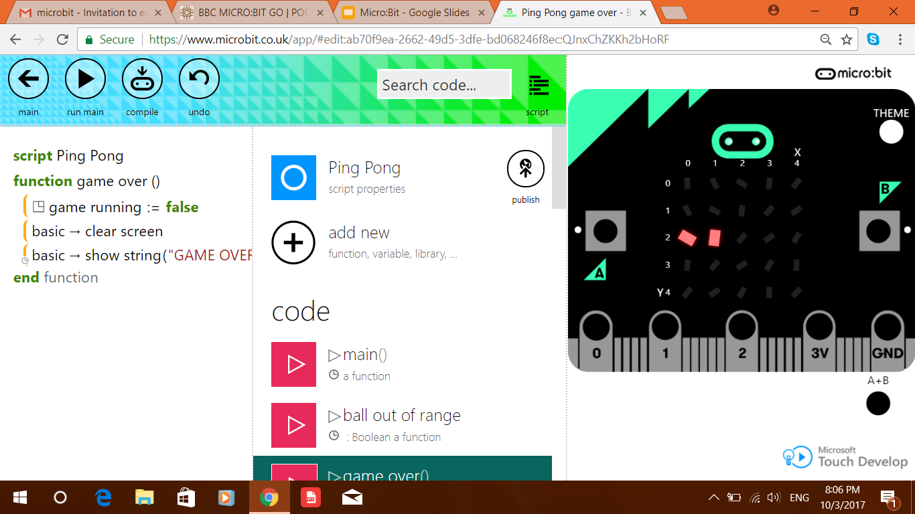
Adding New Functions
To add a new function:
Click “script”
Click “add new”
Click “function”

Slide 6
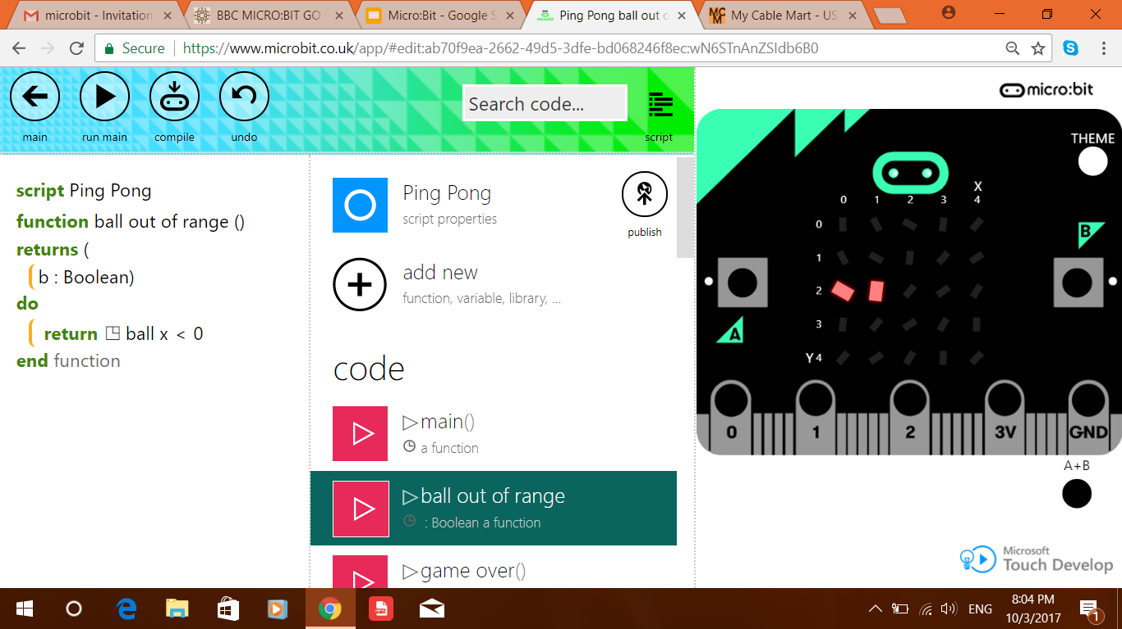
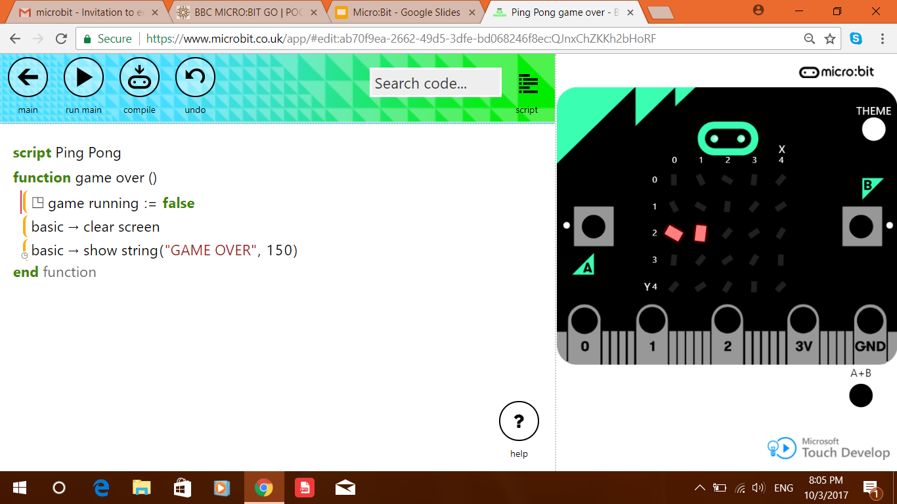
Function 2 and Function 3
Function 2
Function 3

Slide 7


Function 4 and Function 5
Function 4
Function 5

Slide 8

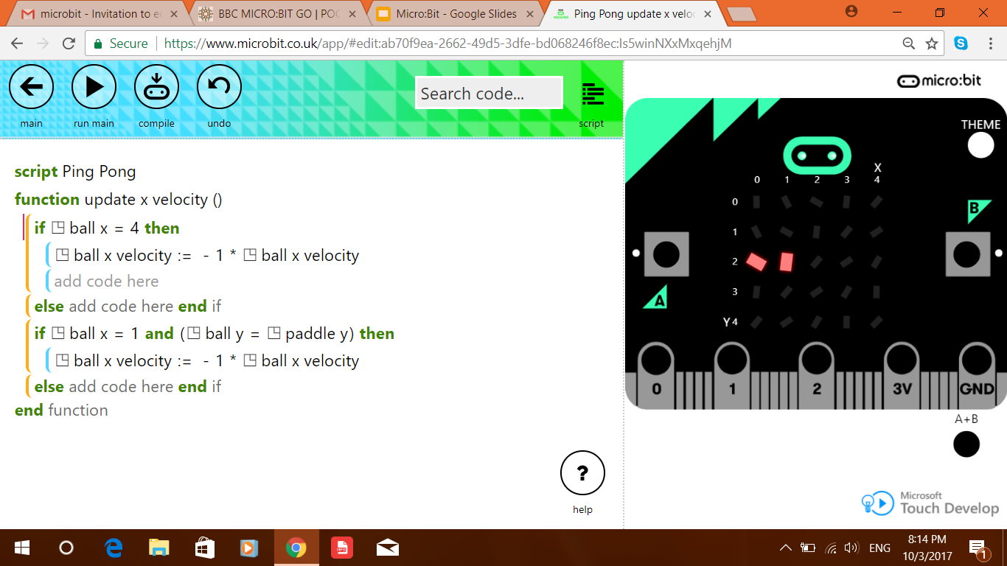
Function 6 and Function 7
Function 6
Function 7

Slide 9

Function 8

Slide 10
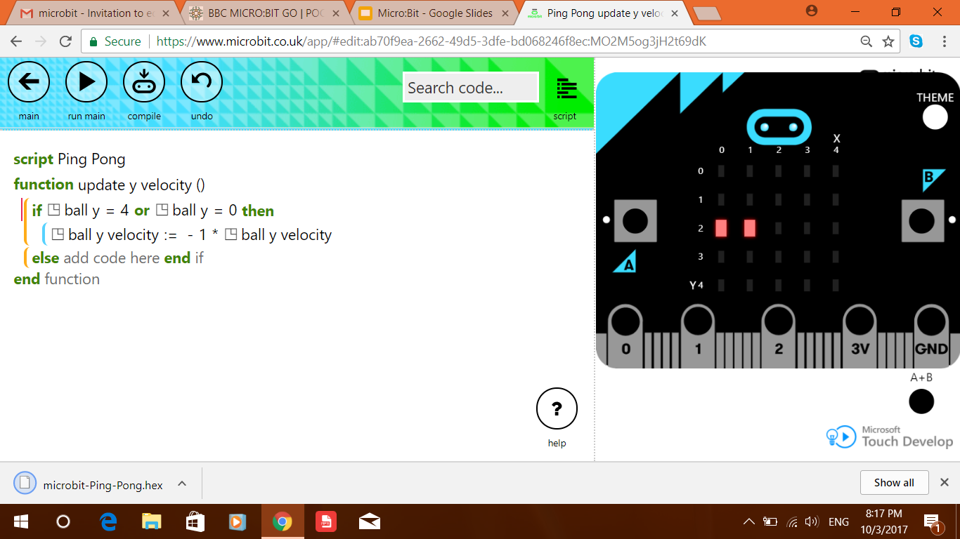
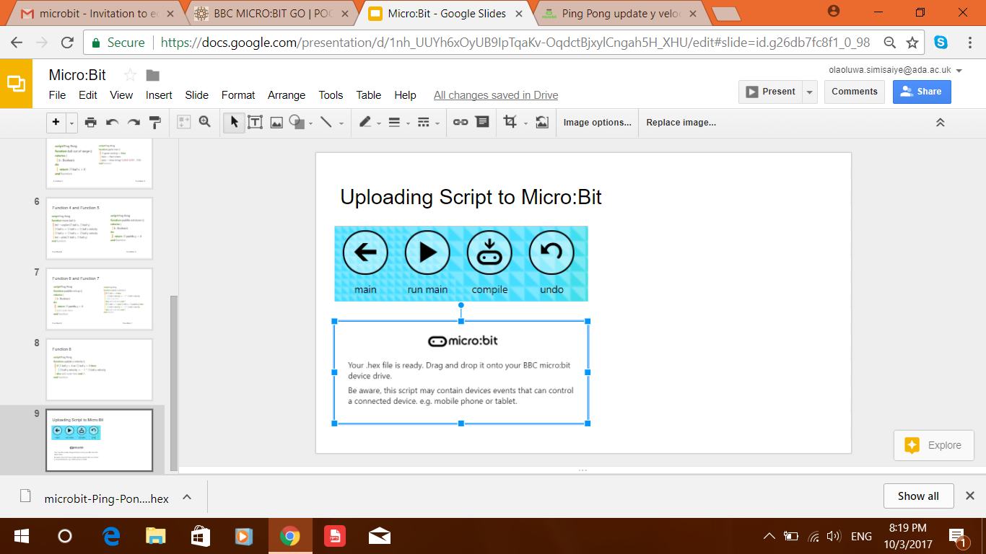
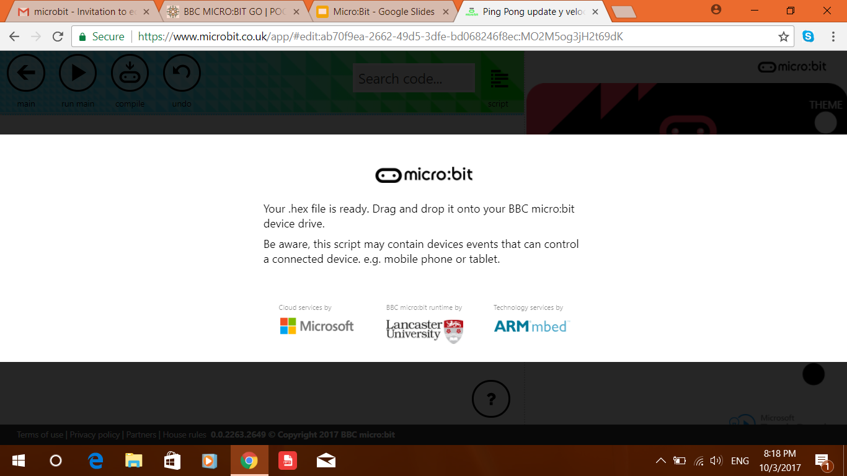
Downloading The Script
To download the script:
Click “compile”
Wait for download message

Slide 11
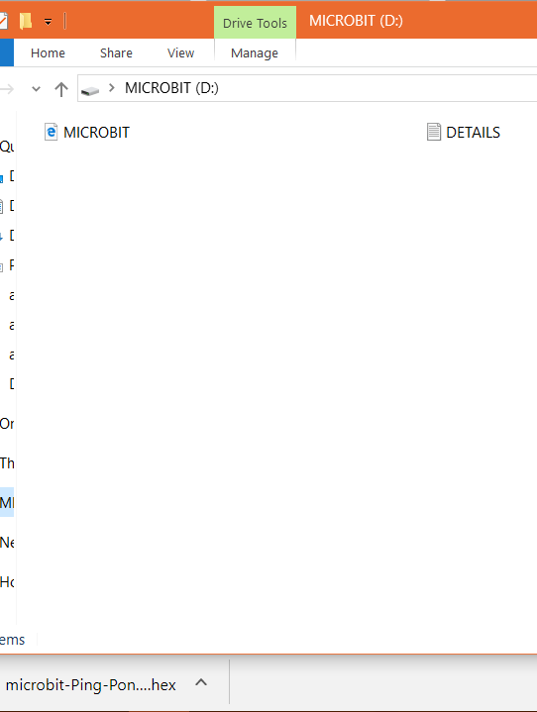
Uploading The Script
To upload the script:
Connect the micro:bit to the computer using the usb cable
Drag and drop the downloaded file into the micro:bit device file

